Slide 1
What Language Model Architecture and Pretraining
Objective Work Best for Zero-Shot Generalization?
Zilong Wang,
Statsjam Bzdok lab,
Oct 30

Slide 2
Typical LLM architectures and pretraining objective pairs
Typically
Causal / Full Language Modeling (CLM / FLM): Autoregressive
"May the force ?"
Decoder-only ----> "May the force be"
Original text:
"May the force be with you"
Masked Language Modeling (MLM): e.g., Span corruption
"May the <X> with you"
Seq2Seq: e.g., translation, summary
Encoder-Decoder ----> "<X> Force be"
Encoder-Decoder ----> “愿原力与你同在”
Notes:
Typically, specific llm architectures are paired with specific pretraining objectives. Decoder models are pretrained with the objective of causal language modeing or some people call it full language modeing. Encoder -decoder are pretrained with Masked language modeling or Seq2seq tasks. But these typical models are limited to specific usages such as listed here.

Slide 3
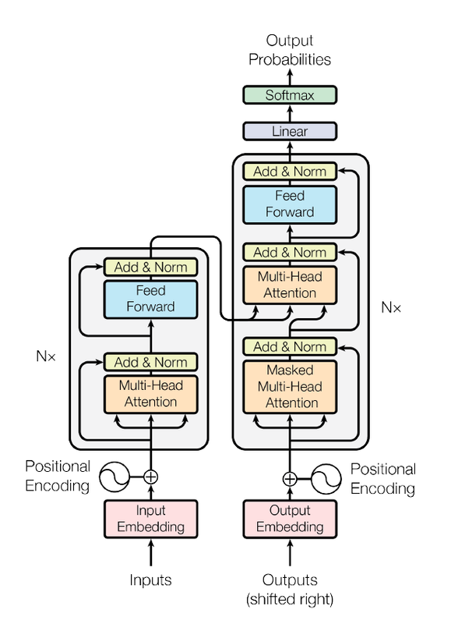
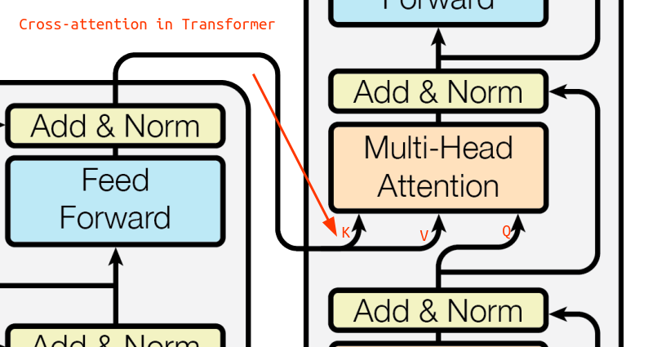
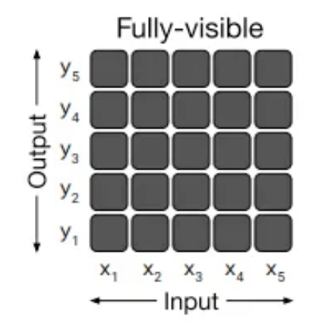
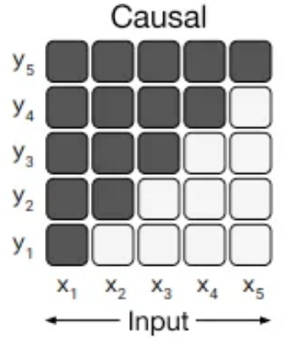
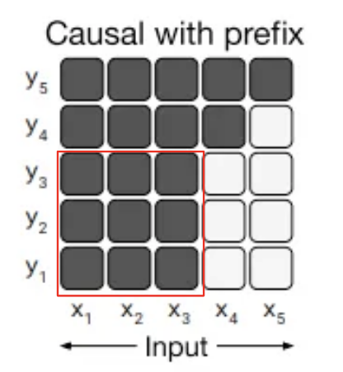

Enc-Dec architecture
Encoder
K V Q
K V Q
Cross attention
<X>
<X> is eating
Notes:
On the left there is the encoder part which takes the source input, and extract the latent representation. on the right there is the decoder part which takes the target output and extract latent representation. Between encoder and decoder there is cross attention to link source information and target information.
In the attention matrix, A light cell indicates that the self-attention mechanism is not allowed to attend to the corresponding cell whereas A dark cell allows self-attention. So in fully visible mask, every output token can attend to every input token. In causal mask, every output token can only attend to itself and all positions before it.. Some researchers also created a casual with prefix or simply non-causal mask, which make a regions fully visible such that tokens in this region can attend to all the other tokens in this region, as the red squared regions shows, but this variant is much less adopted and ultimately performs bad…
Here we have a translation seq2seq task, or you can mask some parts of the input and train it to predict the masked part. Or, after pretraining with MLM or Seq2seq objective, you can adapt it for a prefix language modeling objective by feeding it

Slide 4
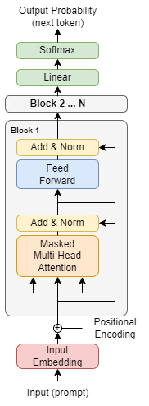
Causal vs Non-causal Decoder-only
No cross attention
No cross attention
source
Notes:
For the decoder model, it’s mostly the same as the decoder part, except that there is no cross attention, and the source input is concatenated with the target output to allow self-attention to access the information from source input.
On the right is the non-causal decoder only model which simply make a regions fully visible such that tokens in this region can attend to all the other tokens in this region, as the red squared region, but this variant is much less adopted,
Notice that you can also turn the decoder part of a encoder-decoder model into non-causal.

Slide 5
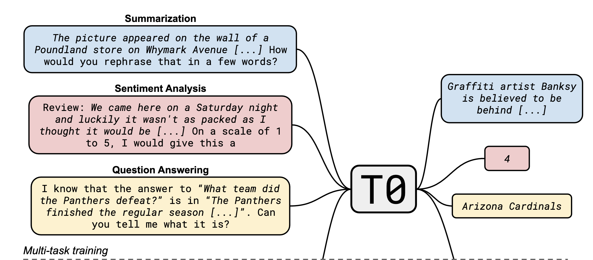
Typical LLM might not be enough for zero-shot generalization
<X> is eating
Multitask fine-tuning
finetune the model with prompts from multiple domains.
Adapt pretrained LLM architecture to a new pretraining objective.
E.g., Given a CLM pretrained Decoder-only model, keep its parameters, turn its causal attention mask into a non-causal attention mask, give further MLM data for pretraining.
No cross attention
<X>
Notes:
But as mentioned, Typical LLM are usually specific to some tasks and might not be enough for zero-shot generalization across multiple tasks. there two ways to improve this. First, Multitask finetuning, compared to transfer learning, this finetune the model with prompts from multiple domains. One model that uses this techinique is T0, which employed Encoder-decoder architecture.
Second, Adapt pretrained LLM architecture to a new pretraining objective.
E.g., Given a CLM pretrained Decoder-only model, keep its parameters, turn its causal attention mask into a non-causal attention mask, give further MLM data for pretraining.
Because there is a higher demands for more integrated tools that are generally suitable for multiple tasks in a few shot or even zero shot setting. So to improve the zero-shot generalization ability, researchers recently proposed two ways.
Zero-shot generalization: Large language models (LLMs) pretrained on unstructured text data have been shown to be capable of performing a wide variety of text processing tasks without additional training.

Slide 6
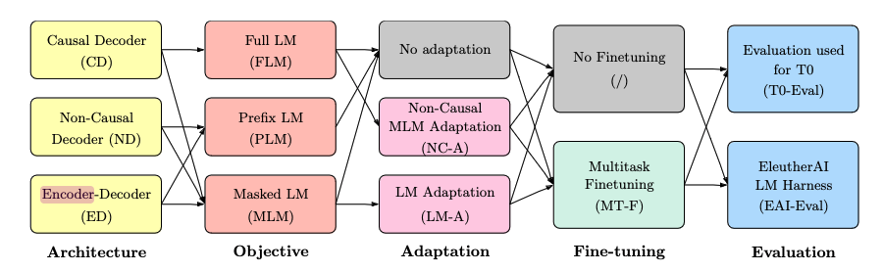
Overview
Notes:
This is definitely a lot of work!!!
Again, the red arrows are the typical approach.

Slide 7
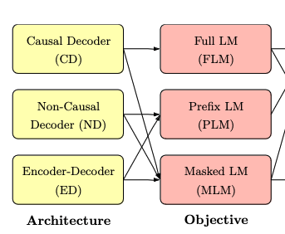
6 architecture-pretraining objective pairs
prefix
Notes:
For prefix language modeling, one defines the prefix where where the decoder attention mask is allowed to be non-causal. Here may the force would be the prefix.

Slide 8
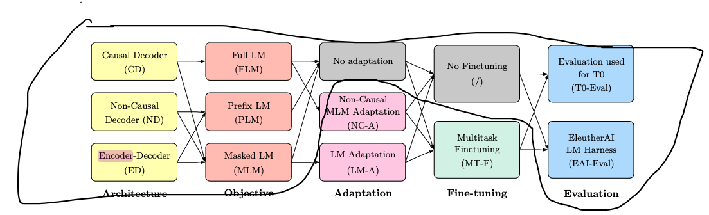
Result 1
After unsupervised pre-training only:
Notes:
In the first scenario, the authors examined the performance After unsupervised pre-training only. They also only considered FULL or Prefix language modeling, because masked language modeling on its own does not yield a model appropriate for zero-shot prompted evaluation

Slide 9
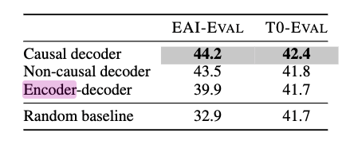
Result 1
After unsupervised pre-training only :
FLM
PLM
PLM
Notes:
After unsupervised pre-training only, Causal decoder models pretrained with a full language modeling objective achieve best zero-shot generalization, WHICH IS in line with current common practices for large language models

Slide 10
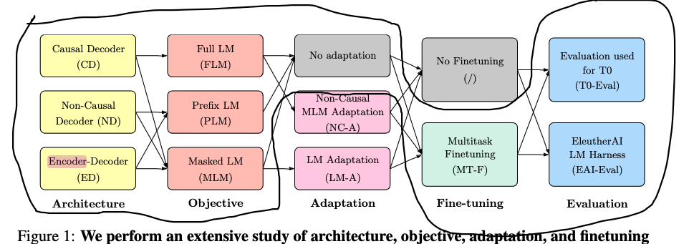
Result 2
After multitask finetuning:
Notes:
In the second scenario, the authors additionally multask finetuned the models.

Slide 11
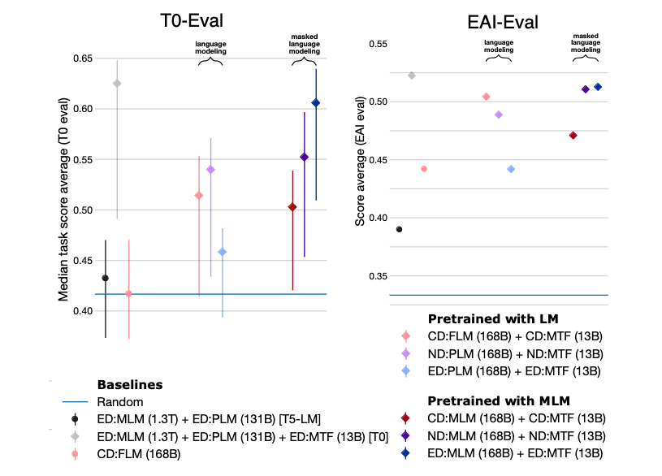
Result 2
After multitask finetuning:
Notes:
After multitask finetuning, Encoder-decoder models trained with masked language modeling achieve the best zero-shot performance among the experiment models. The baseline T0 was shown to be zero-shot generalization SOTA in another paper.
I think also worth noting is that encoder-decoder pretrained with language modeling or decoder only pretrained with masked language modeling were the worst, so at least these two unintuitive combinations are not worth trying.

Slide 12
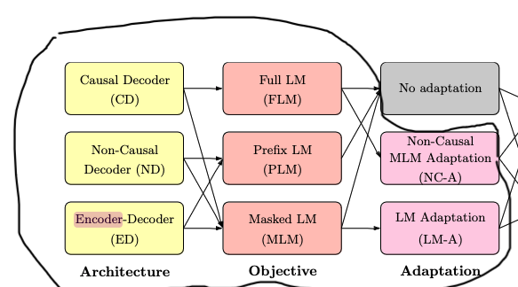
Result 3
Adapt models from one architecture/objective to another
Notes:
The authors proposed two types of adaptions : the orange one represents pretraining a non-causal decoder model with an MLM objective and then further train the model as a causal decoder with a FLM objective (language modeling adaptation). This is done by keeping its parameters, turning its causal attention mask into a non-causal attention mask, giving further MLM data for pretraining. The authors also attempted this adaptation from the decoder portion of an encoder-decoder model, but it performed significantly worse than training from scratch.
The purple one represents pretraining a causal decoder model pretrained with FLM as the objective, then continue training the model as a non-causal decoder using an MLM objective. It is similarly converted by swichting the attention mask.

Slide 13
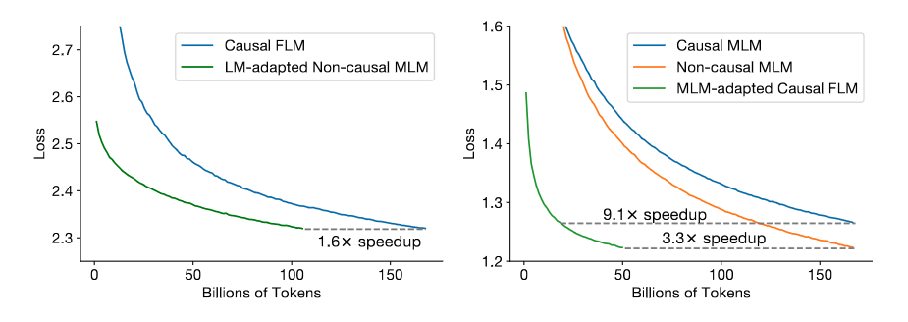
Result 3
Notes:
Here plots the validation loss.the green lines are adapted models, and other lines are original models pretraiend from scratch. As we can see, the adapted models achieves comparable loss with less data. This enables one to obtain both a zero-shot model and an excellent generative model for only 1.3× the cost of training a single model.

Slide 14
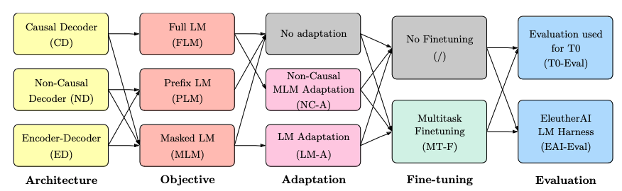
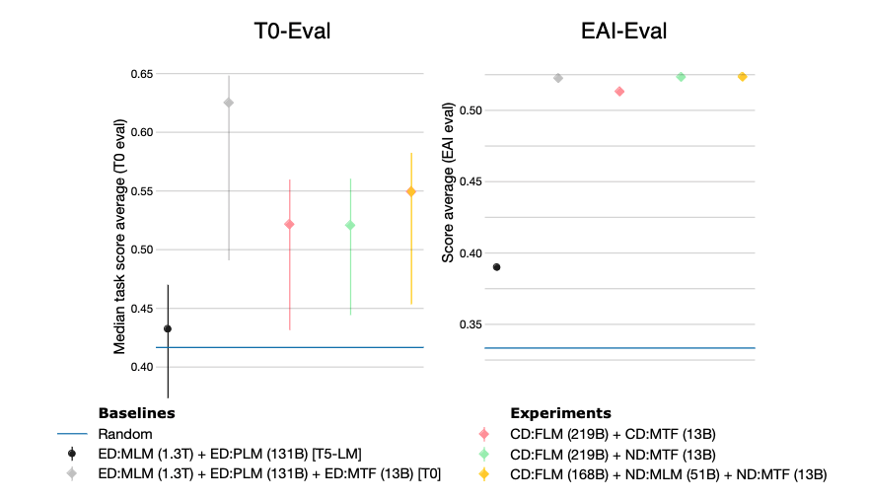
Result 3
Notes:
When evaluated, the orange one is the best compared to other experimental models.
Specifically, to obtain both a generative and a multitask model with the smallest total compute budget possible, the authors recommend starting with a causal decoder-only
model, pretraining it with a full language modeling objective, and then using non-causal masked language modeling adaptation before taking it through multitask finetuning.

Slide 15
The End

Slide 16
Seq2seq
Traditionally better with Enc-Dec.
Decoder-only model concatenate the source and target sequences into a single sequence and train the model on this new collection of sequences.

Slide 17
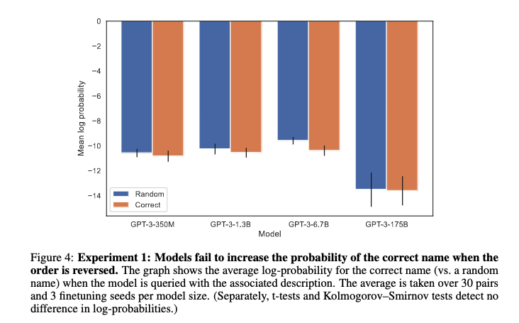
The reversal curse
They find their method is not bidirectional, suggesting that LLMs may store factual associations differently depending on their direction. Meng et al. (2023)
They claim that these models represent factual associations as key-value pairs in their feed-forward layers, . Geva et al. (2021, 2022, 2023)
Notes:
It seems that their results would predict that if a pretrained model was not trained on facts in both directions, it would not generalize to both directions. Our Experiment 1 tests and confirms a closely related prediction.

Slide 18
The bitter lesson
The bitter lesson is based on the historical observations that 1) AI researchers have often tried to build knowledge into their agents, 2) this always helps in the short term, and is personally satisfying to the researcher, but 3) in the long run it plateaus and even inhibits further progress, and 4) breakthrough progress eventually arrives by an opposing approach based on scaling computation by search and learning.
One thing that should be learned from the bitter lesson is the great power of general purpose methods, of methods that continue to scale with increased computation even as the available computation becomes very great. The two methods that seem to scale arbitrarily in this way are search and learning.
the actual contents of minds are tremendously, irredeemably complex; we should stop trying to find simple ways to think about the contents of minds, such as simple ways to think about space, objects, multiple agents, or symmetries.
In summary, what seems intuitive to humans might not work on AI.

Slide 19
Reminder
BERT (Bidirectional Encoder Representations from Transformers): autoencoding, encoder only, Masked Language Modeling. Not good for sequence generation.
GPT: autoregressive / causal, decoder only, has no knowledge of the end of the sentence.
T5 (Text-to-Text Transfer Transformer) / BART (Bidirectional and Auto-Regressive Transformers): seq to seq, bidirectional encoder - autoregressive decoder, has knowledge of both left and right context from encoder and good for sequence generation

Slide 20
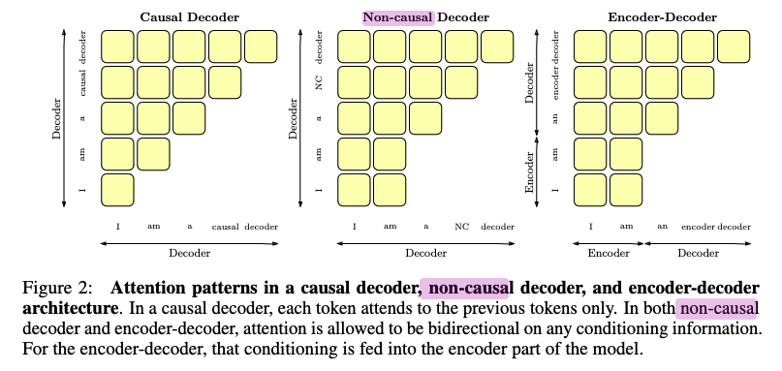
Decoder subtypes
Notes:
But Decoder only models can further be divided into two subtypes.
causal decoder (CD): most recent LLMs, autoregressively predict a text sequence. During training, its attention mask doesn’t allow the model output to look at the sequence after the current token.
Non-causal decoders (ND): are a variant of casual decoder. Its self-attention masking pattern can be changed so that the region of the input sequence corresponding to conditioning information has a non-causal mask (i.e. attention in this region is not restricted to past tokens)

Slide 21
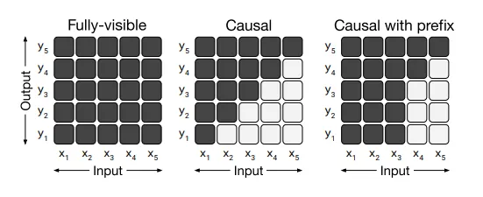
Notes:
In the above figure, various attention mask patterns have been shown which are used in the model. A light cell indicates that the self-attention mechanism is not allowed to attend to the corresponding cell. In the left part, the entire input is visible at each output step, which applies to Encoder-decoder, encoder only models. In the middle part (Causal), the output step cannot view any input from the future which applies to the decoder only model. In the right part (Causal with prefix), the self-attention mechanism uses fully-visible masking on the red-squared regions of the input sequence.
The y-axis shows the tokens being generated, and x-axis are the tokens it can attend to. A black square means the token on the y-axis can attend to the tokens on the x-axis. In non-causal or casual with prefix mask,.

Slide 22
(Unsupervised) Pre-training Objective
Typically, decoder-only LLMs are pretrained using a causal language modeling (CLM) objective with a loss computed on all tokens, here the mask applies on the attention matrix
encoder-decoder models with a masked language modeling (MLM) objective [Taylor, 1953, Devlin et al., 2018], such as span corruption, here the mask applies on the input.

Slide 23
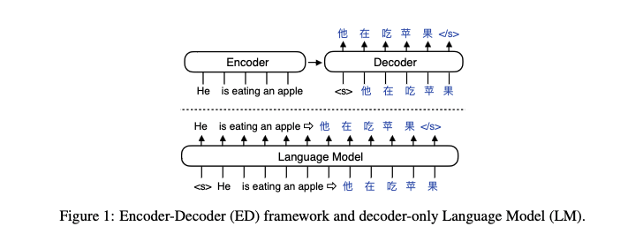

Slide 24
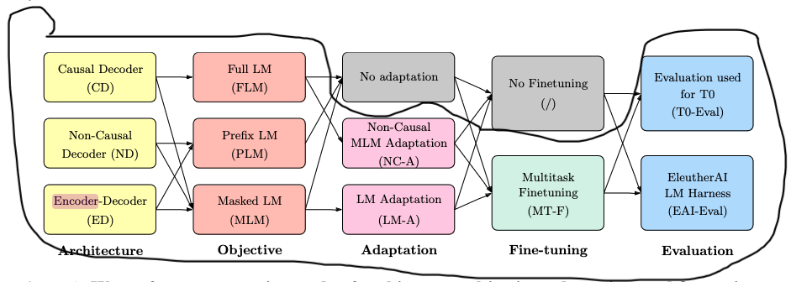
Result 3

